Slide 1
PROJECT RAPTORS REBOUND
DAT 205 Capstone Interim Progress
Group 1 - Bhavika Patil, Cindy Guo, Dennis Hung
Notes:
Good evening Everyone,
Today, we Group 1; Myself – Bhavika, Cindy and Dennis are going to present the progress we have made on our Project RAPTORS REBOUND
[NEXT SLIDE]

Slide 2
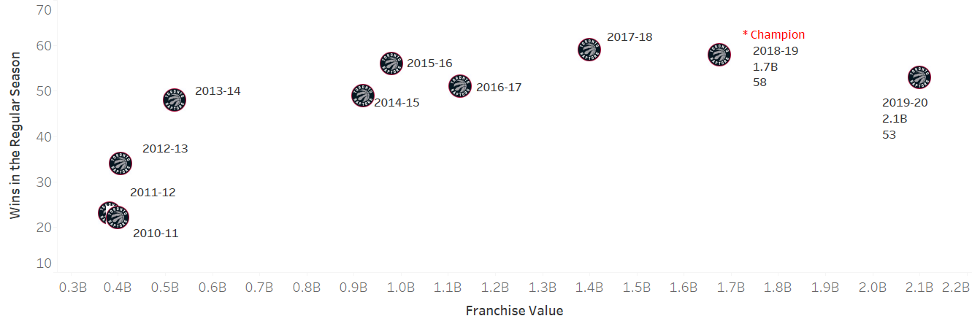
The Client
The Toronto Raptors are an NBA championship team with a USD2.1 billion market capitalization in 2020.
The team’s General Manager (GM) and owners are seeking recommendations on improving the team’s chances at another championship run while preserving the team’s long-term future.
TORONTO RAPTORS
Notes:
The Client
[NEXT 01 – Graph]
Pause for effect
[NEXT 02 – Raptors]
Our client is Toronto Raptors, Currently the only Canadian NBA franchise.
In the year 2020, The Toronto Raptors’ valuation was estimated to be 2.1 billion USD. The raptors won their first NBA Championship in 2019. However, the team’s performance has been in decline since then. This chart shows the wins for each year for the Toronto Raptors.
[NEXT 03 – GM]
The team’s General Manager is seeking recommendations on improving the team’s chances at another championship run while preserving the team’s long-term future. The suggestions will be in the form of improvements to the player roster. The stakeholders intend to either maintain or improve on the number of wins during the regular season and more importantly during the playoffs while retaining the public interest in the team.
[NEXT SLIDE]

Slide 3
Objectives
The primary objective of this analysis is to determine which features are important to the Toronto Raptors team to produce more wins in the regular season and the playoffs.
The secondary objective is to review team players’ performance-to-cost effectiveness.
Focus on the historical player data from 2005 to 2020 as this closely represent the players of the current era.
Notes:
To attain the requirements outlined by the management, we are looking at two objectives
[NEXT 01 – Primary Objective]
The primary objective of this analysis is to determine which features are important to the team to produce more wins in the regular season and the playoffs.
[NEXT 02 - Secondary Objective]
The secondary objective is to review team players’ performance-to-cost effectiveness.
[NEXT 03 – Data scope]
The scope of the initial analysis will be to focus on the Toronto Raptors’ historical player data from 2005 to 2020 as this closely represents the players of the current era. The performance baseline of the team and players will be established using the data for The Toronto Raptors 2019-2020 season. These statistics will be used to indicate performance features for the team and the individual players.
[NEXT SLIDE]

Slide 4
Data
Open access API (nba_api)
PlayerGameLogs
Total ~450K records, 36 features
NBA Player Salaries
ESPN for the historical data
Hoopshype for future data
489 records
NBA PlayByPlay (mention about it)
Decide if we want the db diagrams
Describe the Target and features
Notes:
Data description
Data cleansing, if needed – steps taken – what were the challenges with the data and steps taken to cleanse bring it to usable format (ETL – extract, transform, load steps). Technology/tools used for cleansing/analysis
Methods (methods, relevant outputs)
The data collection for this analysis was a cumbersome process. We have used multiple sources to gather the data.
[NEXT 01 – API]
nba_api is an open access API client library for Python requesting the data via webservices through stats.nba.com. We are using 2 endpoints.
[NEXT 02 – Player Game Logs]
playgamelogs fetches player statistics for each game. This dataset consists of more than 450k rows. We are using 36 features. It has 15K records for the Toronto Raptors alone. We are only showing a few features here, this dataset acts as the main datasource for the analysis.
[NEXT 03 – Play by Play]
PlayByPlay gets all activities for a game, we fetched stats for all games derived from the first Dataset. This dataset has about 10M records and can reference the main dataset by GAME_ID.
[NEXT 04 – Player salaries]
NBA webservice does not provide the salary data. Historical salary data was drawn from ESPN website and the future salary data from HoopsHype website. These were obtained using web scraping in python. We are looking at current 489 NBA players. We can relate this table to the Playergamelogs using the Player name and the Season year.
[Just pause for a couple of seconds]
This diagram is created only for easy understanding of the schema. Since this is not a normalized database; which would be very expensive for this analysis, the relationship keys are not enforced by any constraint.
[Next speaker handoff statement]
Now I shall hand over to Dennis
[NEXT SLIDE]

Slide 5
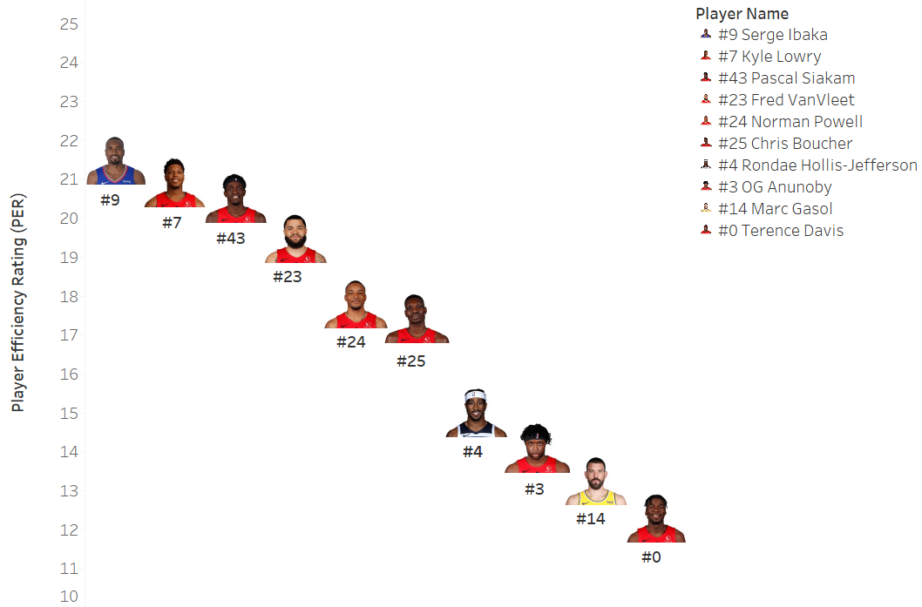
Initial Analysis
Top 10 Toronto Raptors Player Efficiency Rating (PER) for Season Year 2019-20
PER=[ FGM x 85.910 + Steals x 53.897+ 3PTM x 51.757 + FTM x 46.845 + Blocks x 39.190 + Offensive_Reb x 39.190 + Assists x 34.677
+ Defensive_Reb x 14.707 - Foul x 17.174 - FT_Miss x 20.091 - FG_Miss x 39.190- TO x 53.897 ] x (1 / Minutes)
Notes:
[Cindy to take over]
Thank you, Dennis. I will continue on to the next part of Initial Analysis.
[NEXT 01 – The slide is to show the topic for our study]
First, we determine the most efficient players for Toronto Raptors in the season 2019-20. The Player Efficiency Rating (PER) is introduced in our analysis.
PER is John Hollinger's all-in-one basketball rating, which attempts to boil down all of a player's contributions into one number. Here is the formula.
[NEXT 02 – The slide is to show the formula]
PER takes into account accomplishments, such as field goals, free throws, 3-pointers, assists, rebounds, blocks and steals, and negative results, such as missed shots, turnovers and personal fouls. The formula adds positive stats and subtracts negative ones through a statistical point value system. The rating for each player is then adjusted to a per-minute basis.
There are other PER formulas as well which may be different from the one we use.
[NEXT 03 – Player Performance Graph]
This graph shows the top 10 Player Efficiency Rating for Toronto Raptors in the Season 2019-20. The horizontal axis is the player names. The vertical axis is the PER number for each player. The analysis includes both Regular and Playoffs.
[NEXT 04 – Jersey]
The Jersey number is highlighted for each player under the photo.
[NEXT 05 – Serge]
From the PER calculation, Serge ranked No.1 in the season 2019-20 with a value of 21.50.
[NEXT SLIDE]

Slide 6
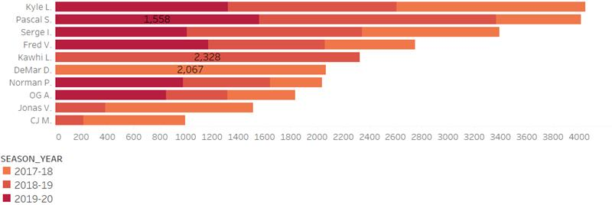
Initial Analysis
Top 10 Toronto Raptors Players by Points for the Seasons 2017-2020
Notes:
[NEXT 01 – Top 10 Toronto Raptors Players by points for the past 3 Seasons]
Let’s talk about who scored the most points in the last 3 seasons.
[NEXT 02 – Graph]
In this graph, it shows the top 10 players and their points. The horizontal axis is the total points scored in the last 3 seasons. The vertical axis is the player names.
We only study the players who scored at least 100 points in both Regular and Playoffs. The different color on the stack bar is for the different seasons. The darker color indicates the recent season vs lighter color for old seasons. Some players may have contracts with Raptors for only one season, we will see only one color on the stack bar.
[NEXT 03 – DeMar]
In 2017-18 season, DeMar was No. 1 with 2067 points.
[NEXT 04 – Kawhi]
In 2018-19 season, Kawhi had the highest score with 2328 points.
[NEXT 05 – Pascal]
In 2019-20 season, Pascal Ranked No. 1 with 1558 points.
[NEXT 06 – Kyle]
In all 3 seasons, Kyle scored the highest points and followed by Pascal.
[Next speaker handoff statement]
Now I shall hand off back to Dennis
[NEXT SLIDE]

Slide 7
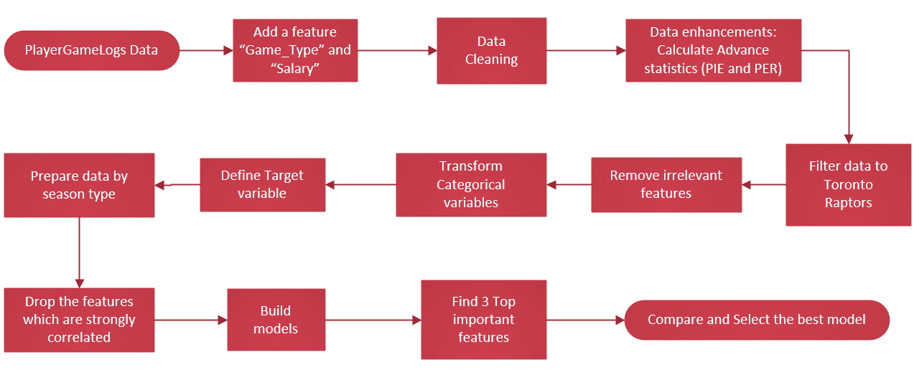
Data Analysis – Phase 1
Notes:
This analysis was done in 2 phases:
The data collection for this analysis was a cumbersome process. We have used multiple sources to gather the data.
[NEXT 01 – API]
nba_api is an open access API client library for Python requesting the data via webservices through stats.nba.com. We are using 2 endpoints.
[NEXT 02 – Player Game Logs]
playgamelogs fetches player statistics for each game. This dataset consists of more than 450k rows. We are using 36 features. It has 15K records for the Toronto Raptors alone. We are only showing a few features here, this dataset acts as the main datasource for the analysis.
[NEXT 03 – Play by Play]
PlayByPlay gets all activities for a game, we fetched stats for all games derived from the first Dataset. This dataset has about 10M records and can reference the main dataset by GAME_ID.
[NEXT 04 – Player salaries]
NBA webservice does not provide the salary data. Historical salary data was drawn from ESPN website and the future salary data from HoopsHype website. These were obtained using web scraping in python. We are looking at current 489 NBA players. We can relate this table to the Playergamelogs using the Player name and the Season year.
[Just pause for a couple of seconds]
This diagram is created only for easy understanding of the schema. Since this is not a normalized database; which would be very expensive for this analysis, the relationship keys are not enforced by any constraint.
[Next speaker handoff statement]
Now I shall hand over to Dennis
[NEXT SLIDE]

Slide 8
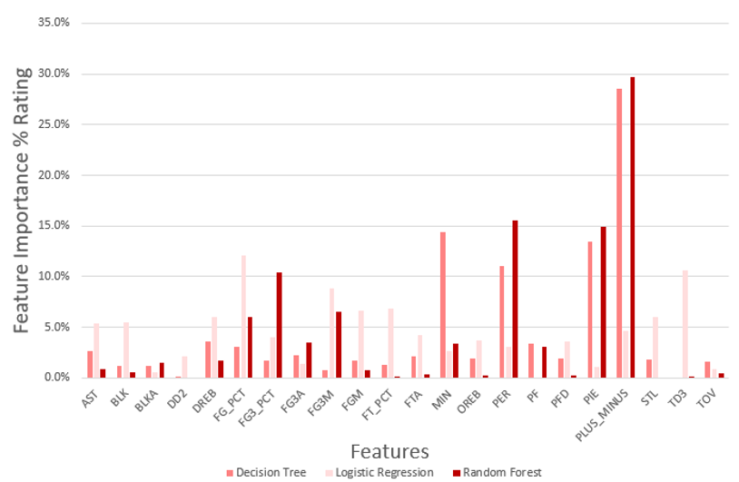
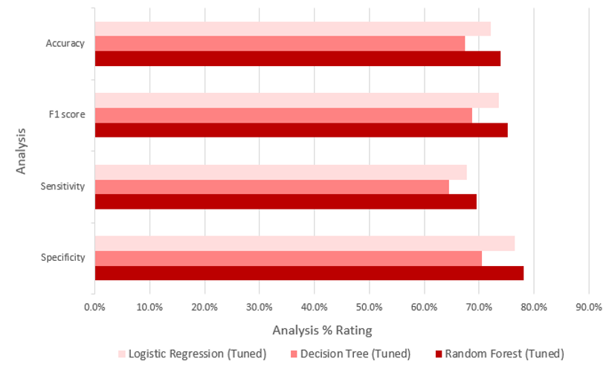
Data Analysis Results – Phase 1
Showcase results we want to from Phase 1 and add animations
Notes:
This analysis was done in 2 phases:
The data collection for this analysis was a cumbersome process. We have used multiple sources to gather the data.
[NEXT 01 – API]
nba_api is an open access API client library for Python requesting the data via webservices through stats.nba.com. We are using 2 endpoints.
[NEXT 02 – Player Game Logs]
playgamelogs fetches player statistics for each game. This dataset consists of more than 450k rows. We are using 36 features. It has 15K records for the Toronto Raptors alone. We are only showing a few features here, this dataset acts as the main datasource for the analysis.
[NEXT 03 – Play by Play]
PlayByPlay gets all activities for a game, we fetched stats for all games derived from the first Dataset. This dataset has about 10M records and can reference the main dataset by GAME_ID.
[NEXT 04 – Player salaries]
NBA webservice does not provide the salary data. Historical salary data was drawn from ESPN website and the future salary data from HoopsHype website. These were obtained using web scraping in python. We are looking at current 489 NBA players. We can relate this table to the Playergamelogs using the Player name and the Season year.
[Just pause for a couple of seconds]
This diagram is created only for easy understanding of the schema. Since this is not a normalized database; which would be very expensive for this analysis, the relationship keys are not enforced by any constraint.
[Next speaker handoff statement]
Now I shall hand over to Dennis
[NEXT SLIDE]

Slide 9
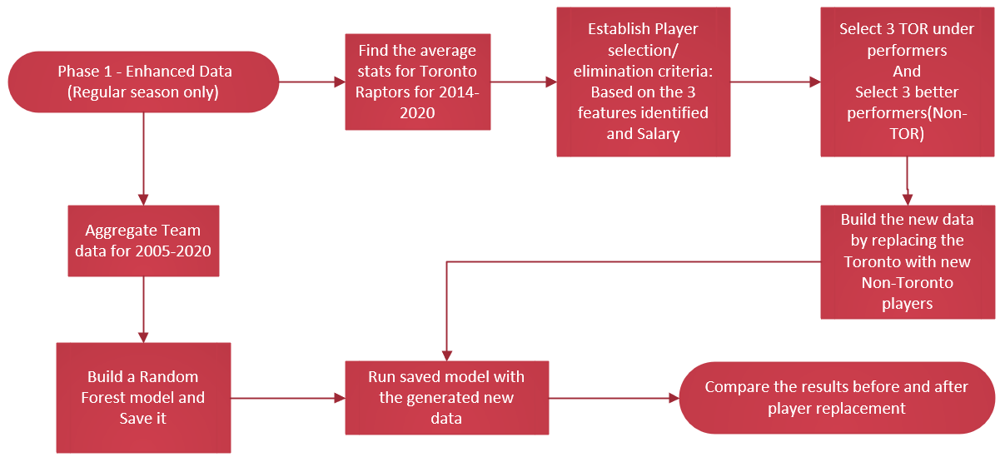
Data Analysis – Phase 2
Notes:
This analysis was done in 2 phases:
The data collection for this analysis was a cumbersome process. We have used multiple sources to gather the data.
[NEXT 01 – API]
nba_api is an open access API client library for Python requesting the data via webservices through stats.nba.com. We are using 2 endpoints.
[NEXT 02 – Player Game Logs]
playgamelogs fetches player statistics for each game. This dataset consists of more than 450k rows. We are using 36 features. It has 15K records for the Toronto Raptors alone. We are only showing a few features here, this dataset acts as the main datasource for the analysis.
[NEXT 03 – Play by Play]
PlayByPlay gets all activities for a game, we fetched stats for all games derived from the first Dataset. This dataset has about 10M records and can reference the main dataset by GAME_ID.
[NEXT 04 – Player salaries]
NBA webservice does not provide the salary data. Historical salary data was drawn from ESPN website and the future salary data from HoopsHype website. These were obtained using web scraping in python. We are looking at current 489 NBA players. We can relate this table to the Playergamelogs using the Player name and the Season year.
[Just pause for a couple of seconds]
This diagram is created only for easy understanding of the schema. Since this is not a normalized database; which would be very expensive for this analysis, the relationship keys are not enforced by any constraint.
[Next speaker handoff statement]
Now I shall hand over to Dennis
[NEXT SLIDE]

Slide 10
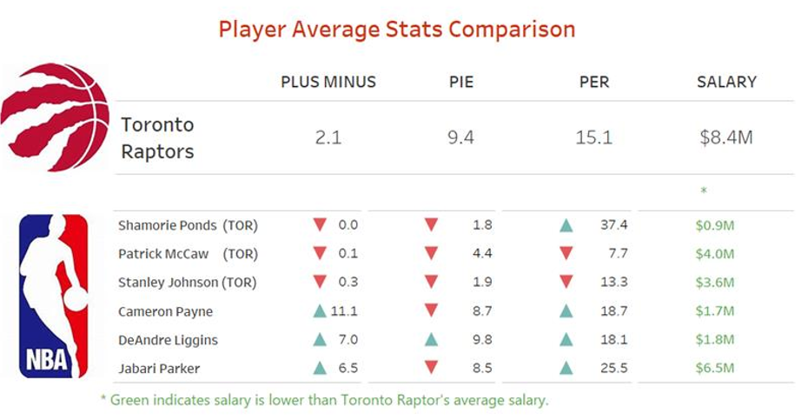
Data Analysis Results – Phase 2 – reorder 10, 11
Do we want to show this?
Notes:
This analysis was done in 2 phases:
The data collection for this analysis was a cumbersome process. We have used multiple sources to gather the data.
[NEXT 01 – API]
nba_api is an open access API client library for Python requesting the data via webservices through stats.nba.com. We are using 2 endpoints.
[NEXT 02 – Player Game Logs]
playgamelogs fetches player statistics for each game. This dataset consists of more than 450k rows. We are using 36 features. It has 15K records for the Toronto Raptors alone. We are only showing a few features here, this dataset acts as the main datasource for the analysis.
[NEXT 03 – Play by Play]
PlayByPlay gets all activities for a game, we fetched stats for all games derived from the first Dataset. This dataset has about 10M records and can reference the main dataset by GAME_ID.
[NEXT 04 – Player salaries]
NBA webservice does not provide the salary data. Historical salary data was drawn from ESPN website and the future salary data from HoopsHype website. These were obtained using web scraping in python. We are looking at current 489 NBA players. We can relate this table to the Playergamelogs using the Player name and the Season year.
[Just pause for a couple of seconds]
This diagram is created only for easy understanding of the schema. Since this is not a normalized database; which would be very expensive for this analysis, the relationship keys are not enforced by any constraint.
[Next speaker handoff statement]
Now I shall hand over to Dennis
[NEXT SLIDE]

Slide 11
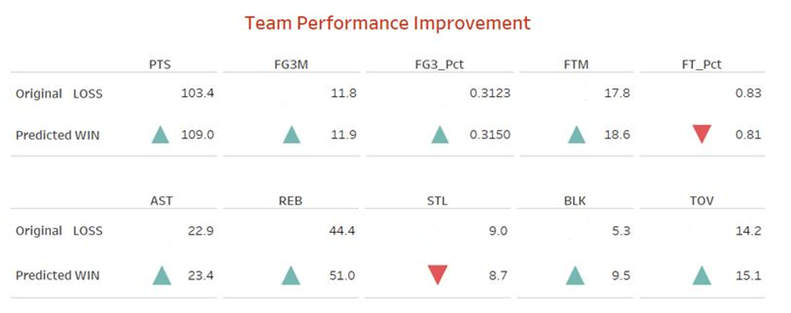
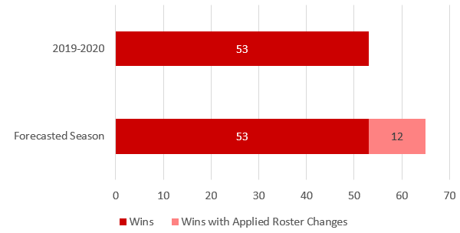
Results
Make better and add animations
Notes:
The data collection for this analysis was a cumbersome process. We have used multiple sources to gather the data.
[NEXT 01 – API]
nba_api is an open access API client library for Python requesting the data via webservices through stats.nba.com. We are using 2 endpoints.
[NEXT 02 – Player Game Logs]
playgamelogs fetches player statistics for each game. This dataset consists of more than 450k rows. We are using 36 features. It has 15K records for the Toronto Raptors alone. We are only showing a few features here, this dataset acts as the main datasource for the analysis.
[NEXT 03 – Play by Play]
PlayByPlay gets all activities for a game, we fetched stats for all games derived from the first Dataset. This dataset has about 10M records and can reference the main dataset by GAME_ID.
[NEXT 04 – Player salaries]
NBA webservice does not provide the salary data. Historical salary data was drawn from ESPN website and the future salary data from HoopsHype website. These were obtained using web scraping in python. We are looking at current 489 NBA players. We can relate this table to the Playergamelogs using the Player name and the Season year.
[Just pause for a couple of seconds]
This diagram is created only for easy understanding of the schema. Since this is not a normalized database; which would be very expensive for this analysis, the relationship keys are not enforced by any constraint.
[Next speaker handoff statement]
Now I shall hand over to Dennis
[NEXT SLIDE]

Slide 12
Recommendations
Add 4 points from notes – remove the name from #4
Notes:
For improvements to the TOR roster, the organization is to look at Non-TOR players with higher values in PLUS_MINUS, PER, and PIE compared to their current roster. These statistics hold potential values in producing team wins and are underutilized by their current teams.​
Alternatively, Field Goal % (FG_PCT) and 3-pointers % (FG3_PCT) are to look out for player efficiency.
We recommend players with higher important feature values than the average TOR player and a salary below the average of a TOR player.
There is an evidence of underutilization of a selected TOR player (Shamorie Ponds). We advocate exploring his utilization or replacing him.
[NEXT 0x – key statement for animation]
[Speaker’s talking points on the current slide item]
[NEXT SLIDE]

Slide 13
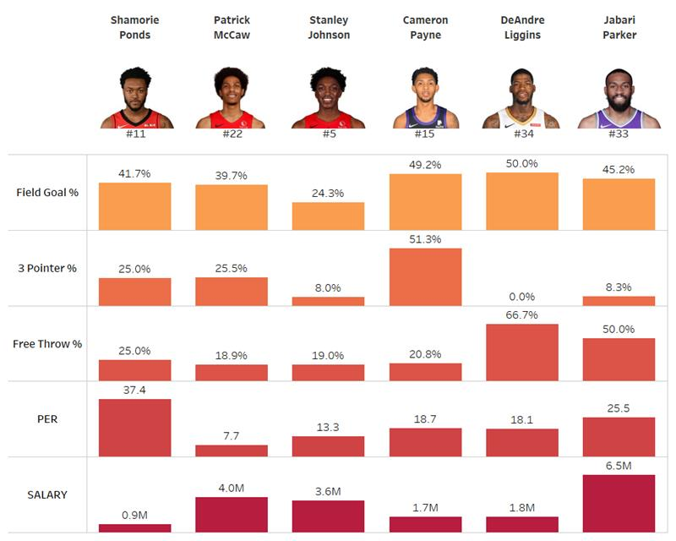
Recommendations
Notes:
For improvements to the TOR roster, the organization is to look at Non-TOR players with higher values in PLUS_MINUS, PER, and PIE compared to their current roster. These statistics hold potential values in producing team wins and are underutilized by their current teams.​
Alternatively, Field Goal % (FG_PCT) and 3-pointers % (FG3_PCT) are to look out for player efficiency.
We recommend players with higher important feature values than the average TOR player and a salary below the average of a TOR player.
There is an evidence of underutilization of a selected TOR player (Shamorie Ponds). We advocate exploring his utilization or replacing him.
[NEXT 0x – key statement for animation]
[Speaker’s talking points on the current slide item]
[NEXT SLIDE]

Slide 14
Limitations
Toronto Raptors only
Qualitative factors
Ponds(describe about need of further study)
Notes:
This analysis is limited to Toronto Raptors only. As the teams change, the important features for those teams can sway. There are qualitative factors that affect the performance of a player and are beyond the scope of this project. These include but are not limited to the player’s:
Health
Rapport with the team
Satisfaction with the coaching
Placement in the games
Happiness with the contract
Personal life
There is a player selected to be replaced on the Toronto roster. Ponds who is new to the roster with only 4 regular season games is seen as a low-value player in terms of PLUS_MINUS and PIE but has a very high PER. This mainly is due to a lack of usage, but additional data is required.
[NEXT 0x – key statement for animation]
[Speaker’s talking points on the current slide item]
[NEXT SLIDE]

Slide 15

THANK YOU
Notes:
This concludes our interim progress presentation.
Are there any questions?
Are there any ideas or suggestions?

Slide 16
BLANK Delete everything from this slide onwards

Slide 17
Reference Instructions
Cover: Informative title, team number and member names
Provide a brief background of organization/problem addressed.
Business problem/opportunity (stakeholder, challenge/opportunity, humanity considerations)
Data mining problem (supervised/unsupervised, explanatory/predictive, how to be deployed)
Data description
Data cleansing, if needed – steps taken – what were the challenges with the data and steps taken to cleanse bring it to usable format (ETL – extract, transform, load steps). Technology/tools used for cleansing/analysis
Methods (methods, relevant outputs)
Evaluation (metrics of interest, benchmark, comparison)
Implications – so what can business/org do with findings/actions
Recommendations (what should the client be aware of? problems you encountered, suggestions for future data collection or analysis, etc.)
Notes:
[NEXT 01 – Feature Importance]
We had each model determine feature importance. For comparison purposes, we simply took the top 10 features as determined by each model. Focusing on our favored models
[NEXT 02 – Forest]
(center
[NEXT 03 – Logistic]
and right) these models have 3 features in common in the top 5 which are PLUS_MINUS, SEASON_YEAR_code, 3Pts FG% (FG3_PCT) .
As preliminary recommendation the Raptors’ game outcomes are impacted by players with high PLUS_MINUS and 3Pts FG% (FG3_PCT) Simply means you score more efficiently, you win games but we will need to better understand if SEASON_YEAR_code is an acceptable feature to keep. This may all change as we tune the models.
[NEXT SLIDE]

Slide 18
[Template - Insert Title]
Notes:
[name to take over,]
Thank you, [Insert name]. Hello all, this is [Insert name]. I will continue to talk about [Insert next subject].
Thank you [Insert name]. I will continue on to the next part of [Insert next subject].
[NEXT 0x – key statement for animation]
[Speaker’s talking points on the current slide item]
[Next speak handoff statement]
Now I shall hand off to [Insert name]
[NEXT SLIDE]

Slide 19
Assumptions
01
Toronto Raptors only Play for NBA
02
The stats of games before 2005 are irreverent for current performers
Notes:
[NEXT 0x – key statement for animation]
[Speaker’s talking points on the current slide item]
[NEXT SLIDE]

Slide 20
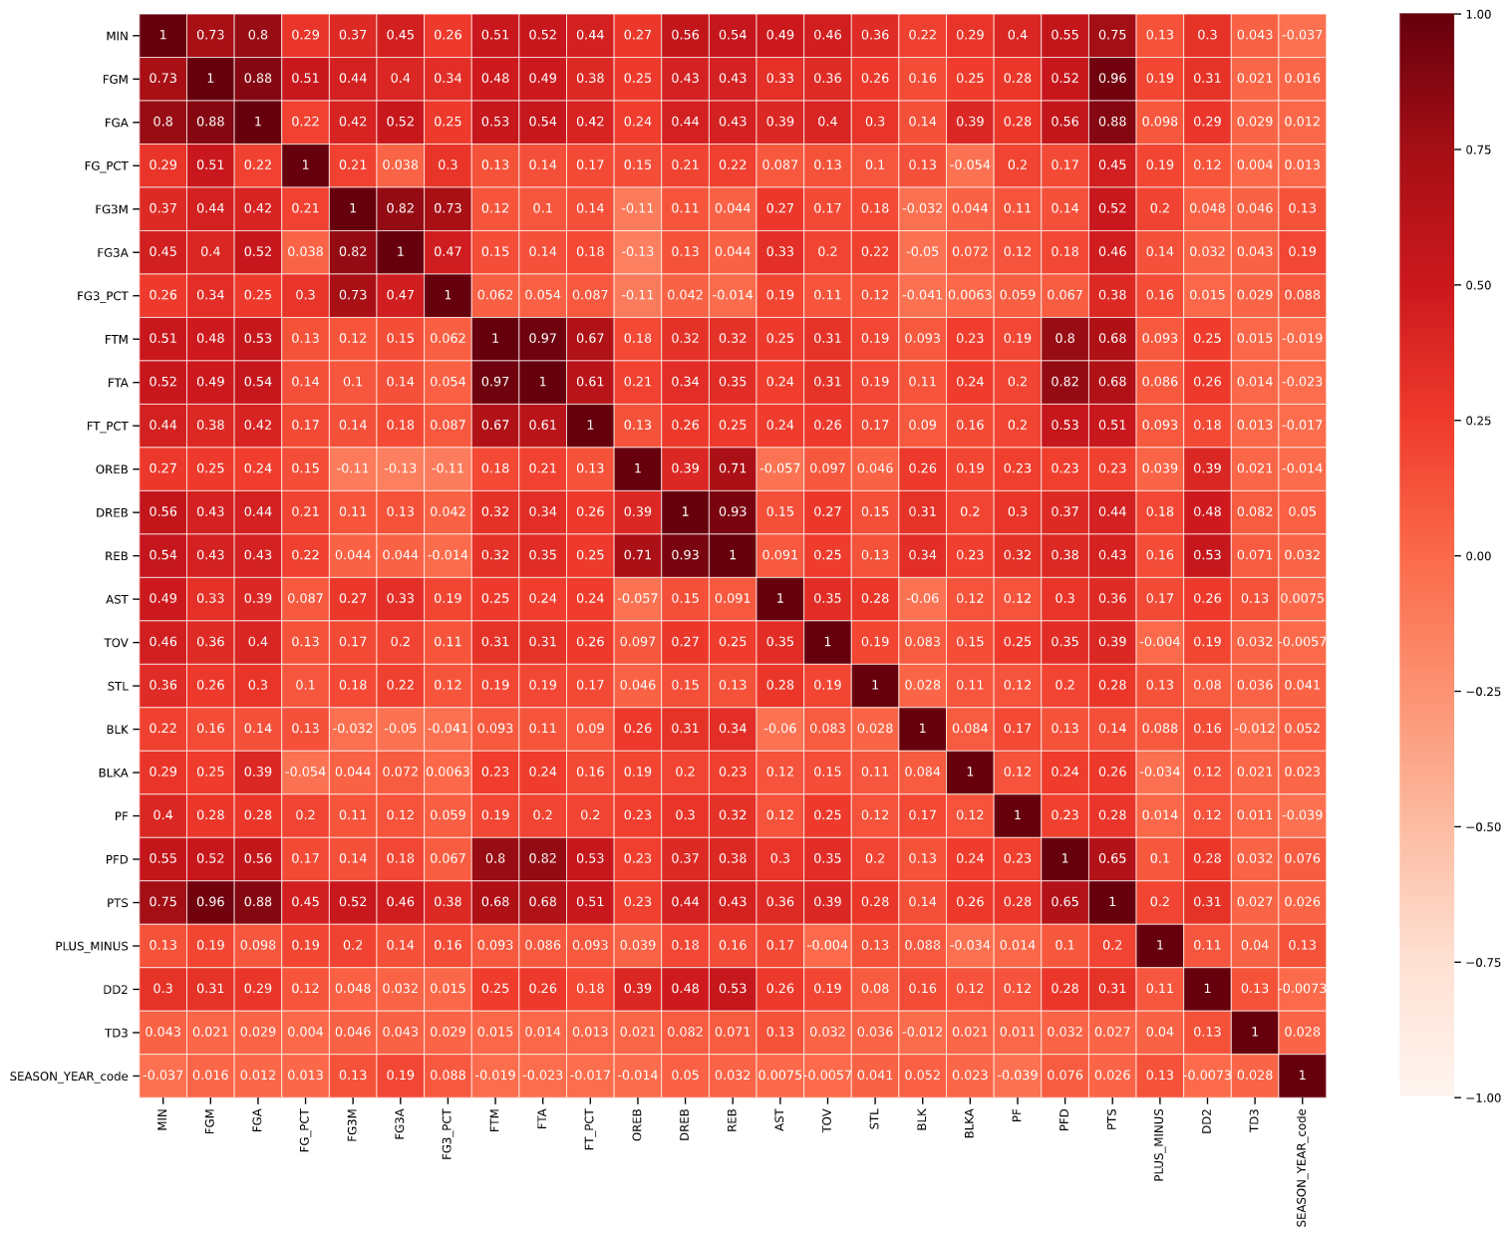
Preliminary Results
Data cleansing
Transformation
Enhancing
Encoding
Reducing
Correlation matrix
Notes:
[Dennis to take over,]
I will continue on to the next part of showing you our Preliminary Results. Note these results are before any tuning is applied.
[NEXT 01 – Data cleaning]
From an initial analysis of the data we found 740 Preseason records with null values. Given this was Pre Season data for a redundant feature (player name) we opted to drop this data group from the analysis.
[NEXT 02 – Transformation]
Next, we looked transforming the data by Enhancing, Encoding, and Reducing
[NEXT 03 – Transformation details]
We enhanced the data (adding in features such as Game_Type to separate data by 3 groups Pre season, Regular Season, and Playoffs)
Categorical features were encoded to use numerical values by mapping or Label Encoding (ie SEASON_YEAR)
To reduce dataset further we drop visibly irrelevant features
As Bhavika mentioned earlier there were 30 features that were initially dropped as these were only rankings used for fantasy drafting (aka sport betting)
Another 8 more numerical/categorical features were drop as theses were providing redundant player or game specific information
unwanted_numerical_Features = ['PLAYER_ID', 'TEAM_ID']
unwanted_categorical_Features = ['PLAYER_NAME', 'TEAM_ABBREVIATION', 'TEAM_NAME', 'GAME_ID', 'GAME_DATE', 'MATCHUP’]
This reduced our overall dataset to 26 features for the preliminary analysis which includes our target feature (WL for WinLoss)
[NEXT 04 – Correlation matrix]
Next, we further wanted to see the correlation between features. Here we line up our 25 features on the XY axis to determine how closely related each of these features are to each other. A dark red or 1 value represents a direct correlation and a light red or white is 0 for little or no relation.
​
[NEXT 04 – heat map focus]
Highlighted boxes indicate high correlation between some features (It is greater than 0.8 ). We were able to dropped 6 more features to reduce this feature redundancy: unwanted_list_02 = ['PTS', 'FGA', 'FG3M', 'FTM', 'PFD', 'REB’]
[NEXT SLIDE]

Slide 21
Preliminary Results – Correlation Matrix
Notes:
[Dennis to take over,]
I will continue on to the next part of showing you our Preliminary Results. Note these results are before any tuning is applied.
[NEXT 01 – Correlation matrix]
Of the original features
Another 8 more numerical/categorical features were drop as theses were providing redundant player or game specific information
unwanted_numerical_Features = ['PLAYER_ID', 'TEAM_ID']
unwanted_categorical_Features = ['PLAYER_NAME', 'TEAM_ABBREVIATION', 'TEAM_NAME', 'GAME_ID', 'GAME_DATE', 'MATCHUP’]
Thus reduced our overall dataset to 26 features for the preliminary analysis which includes our target feature (WL for WinLoss)
We created a correlation matrix between features. Here we line up our 25 features on the X and Y axis to determine how closely related each of these features are to each other. A dark red or 1 value represents a direct correlation and a light red or white is 0 for little or no relation.
​
[NEXT 02 – heat map focus]
Highlighted boxes indicate high correlation between some features (It is greater than 0.8 ). We were able to dropped 6 more features to reduce this feature redundancy: unwanted_list_02 = ['PTS', 'FGA', 'FG3M', 'FTM', 'PFD', 'REB’]
[NEXT SLIDE]

Slide 22
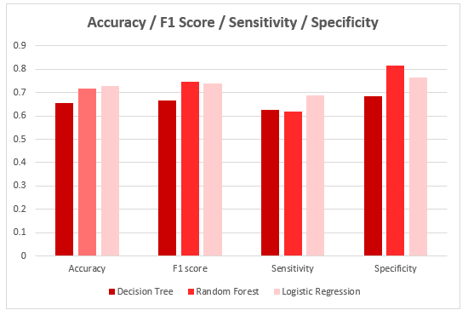
Preliminary Results
Notes:
For our analysis we compared the performance of these 3 models (Decision Tree, Random Forest, Logistic Regression) to 4 metrics:
[NEXT 01 - show graph]
Accuracy – How well the model make True predictions
F1-Score - How well the model make Negative predictions
Sensitivity - The test of confirming True Positives.
Specificity – The test of confirming True Negatives
When comparing the 3 different models, it was a coin toss between Random Forest and Logistic Regression . The metrics of each model were quite similar for
[NEXT 02 – Focus on accuracy and F1 scores]
Accuracy (71.9% vs 72.8%) and F1 scores (74.7% vs 74.1%). The separate was much more noticeable for
[NEXT 03 – Focus on other 2 ]
Sensitivity (61.9% vs 69%) and Specificity (81.7% vs 76.6%).
[NEXT SLIDE]

Slide 23
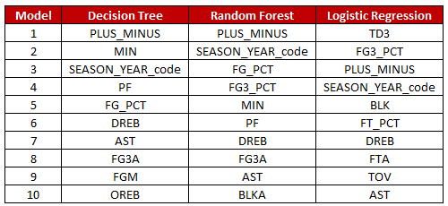
Preliminary Results
Feature Importance
Notes:
[NEXT 01 – Feature Importance]
We had each model determine feature importance. For comparison purposes, we simply took the top 10 features as determined by each model. Focusing on our favored models
[NEXT 02 – Forest]
(center
[NEXT 03 – Logistic]
and right) these models have 3 features in common in the top 5 which are PLUS_MINUS, SEASON_YEAR_code, 3Pts FG% (FG3_PCT) .
As preliminary recommendation the Raptors’ game outcomes are impacted by players with high PLUS_MINUS and 3Pts FG% (FG3_PCT) Simply means you score more efficiently, you win games but we will need to better understand if SEASON_YEAR_code is an acceptable feature to keep. This may all change as we tune the models.
[NEXT SLIDE]

